Slide 1
Fitness progress using Excel
K.KATHIRAVAN
STUDENT NAME:
REGISTER NO:
DEPARTMENT:
COLLEGE
312204898, asunm219unm219ncas2225cc11556
BCOM GENERAL
Nazareth College of arts and science

Slide 2
PROJECT TITLE
Fitness progress using Excel

Slide 3


AGENDA
Problem Statement
Project Overview
End Users
Our Solution and Proposition
5.Modelling Approach
6.Results and Discussion
7.Conclusion
3/21/2024 Annual Review

Slide 4

PROBLEM STATEMENT
A fitness progress makes a person to know about his progress in his body to enhance his motivation. As to make a timeline progress of his body makes him to know about himself

Slide 5

PROJECT OVERVIEW
The project is to make the progress of his body like height weight and size.

Slide 6

WHO ARE THE END USERS?
Person who are fond of physical activities
and always on development of thier own body are the end users of this project

Slide 7

OUR SOLUTION AND ITS VALUE PROPOSITION
Preparing the perfect diet plan to achieve the estimated fitness

Slide 8

THE "WOW" IN OUR SOLUTION
It enables the users to attain and achieve and maintain tge progress who were beginners and who were new to that field
3/21/2024 Annual Review
8

Slide 9
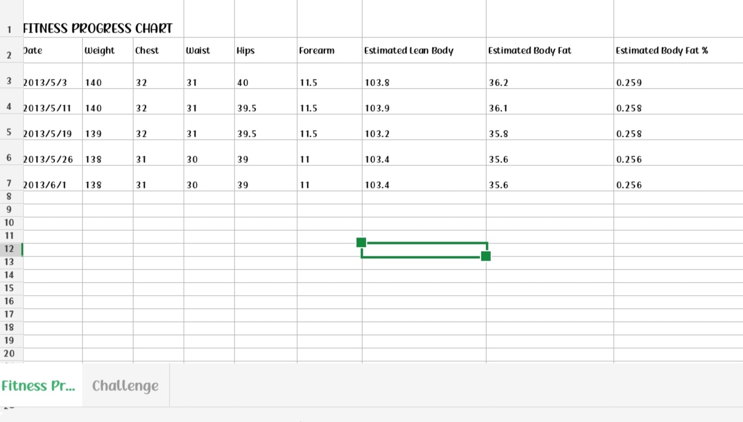
RESULTS
9

Slide 10
conclusion

